Slide 1
Searching Techniques
One of the most basic techniques in AI
  Underlying sub-­‐module in most AI systems
Can solve many problems that humans are not good at (achieving super-­‐human performance)
Useful as a general algorithmic technique for solving many non-­‐AI problems.

Slide 2
How do we plan our holiday?
Required: various preferences and constraints to develop a schedule.
An important technique in developing such a schedule is
“hypothetical” reasoning.
Example: On holiday in England
  Currently in Edinburgh
  Flight leaves tomorrow from London
    Need plan to get to the plane
    If I take a 6 am train where will I be at 2 pm? Will I be still able to get to the airport on time?

Slide 3
How do we plan our holiday?
This kind of hypothetical reasoning involves asking
  What state will I be in after taking certain actions, or after certain sequences of events?
Reason about particular sequences of events or actions one should try to bring about to achieve a desirable state.
Search is a computational method for encapsulating such kind of reasoning.

Slide 4
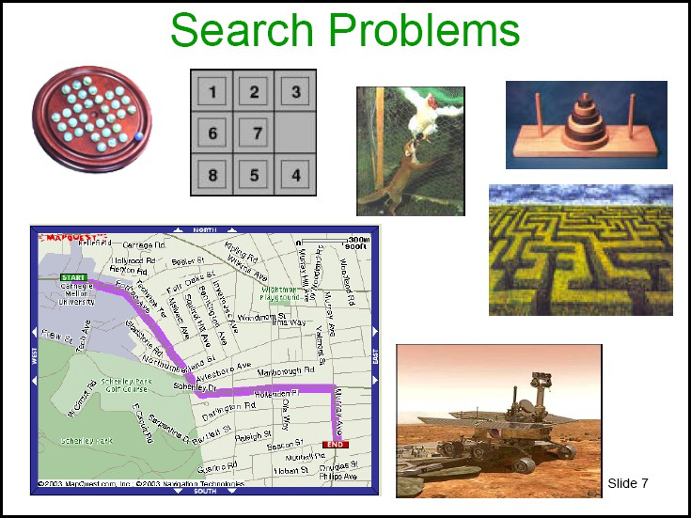
Many problems can be solved by search:

Slide 5
Why Search?
Successful
  Success in game playing programs based on search.
  Many other AI problems can be successfully solved by search.
Practical
  Many problems do not have specific algorithms for solving them. Casting as search problems is often the easiest way of solving them.
  Search can also be useful in approximation (e.g., local search in optimization problems).
  Problem specific heuristics provides search with a way of exploiting extra knowledge.
Some critical aspects of intelligent behaviour, e.g., planning, can be naturally cast as search.

Slide 6
Limitations of Search
There are many difficult questions that are not resolved by search. In particular, the whole question of how does an intelligent system formulate the problem it wants to solve as a search problem is not addressed by search.
Search only shows how to solve the problem once we have it correctly formulated.

Slide 7
Representing a problem: The Formalism
To formulate a problem as a search problem we need:
STATE SPACE: Formulate a state space over which we perform search. The state space is a computational representation of the states (configurations of situations) of the real problem.
ACTIONS or STATE SPACE Transitions: Formulate actions that allow one to move between different states. Actions reflect steps one can take in the real problem but operate on the state space instead.
INITIAL or START STATE and GOAL: Identify the initial state that best represents the starting conditions, and the goal or condition one wants to achieve.
Heuristics: Formulate various heuristics (factors) to help guide the search process.

Slide 8
The Formalism
Once the problem has been formulated as a state space search, various algorithms can be utilized to solve the problem.
A solution to the problem will be a sequence of actions / moves that can transform the current state into a state where the desired ‘goal’ condition holds.

Slide 9
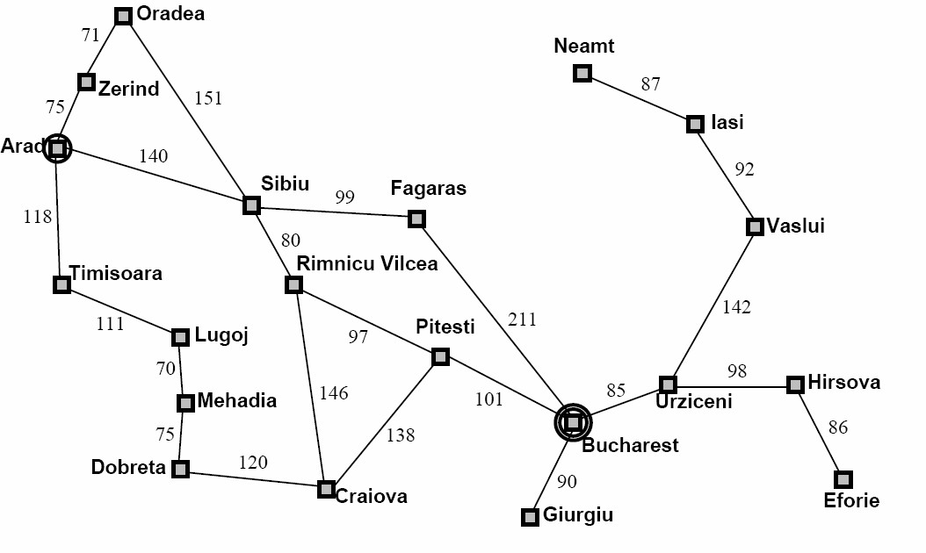


Example 1: Romania Travel.
Currently in Arad, need to get to Bucharest by tomorrow to catch a flight. What is the State Space?

Slide 10
Example 1.
State space:
  States: the various cities you could be located in.
    Abstraction: Ignoring low level details of driving, where on the road between cities, etc.
  Actions: drive between neighboring cities.
  Initial state: in Arad
  Desired condition (Goal): be in a state where you are in Bucharest. (How many states satisfy this condition?)
Solution:
The sequence of cities one must to travel through to get to Bucharest.

Slide 11
Example 2: Filling Water Jugs
Statement:
We have a 3 gallon jug and a 4 gallon jug. We can fill either jug to the top from a tap, we can empty either jug, or we can pour one jug into the other (at least until the other jug is full).
  States: pairs of numbers (gal3, gal4) where gal3 is the number of gallons in the 3 gallon jug, and gal4 is the number of gallons in the 4 gallon jug.
  Actions: Empty-­‐3-­‐Gallon, Empty-­‐4-­‐Gallon, Fill-­‐3-­‐Gallon, Fill-­‐4-­‐ Gallon, Pour-­‐3-­‐into-­‐4, Pour 4-­‐into-­‐3.
  Initial state: Various, e.g., (0,0)
  Desired condition (Goal): Various, e.g., (0, 2) or (*, 3) where * means we don't care.

Slide 12
Example 2.
Some observations:
  If we start off with gal3 and gal4 as an integer, we can only reach integer values.
  Some values, e.g., (1,2) are not reachable from some initial state, e.g., (0,0).
  Some actions do not change the state,
    e.g., (0,0) → Empty-­‐3-­‐Gallon → (0,0)

Slide 13
Algorithms for Search
Inputs:
A specified initial state (a specific world state)
A successor function S(x) = {set of states that can be reached from state x via a single action}.
A goal test a function that can be applied to a state and returns true if the state satisfies the goal condition.
An action cost function C(x,a,y) which determines the cost of moving from state x to state y using action a → (C(x,a,y) = ∞ if a does not yield y from x).
Different actions might generate the same move of x → y.

Slide 14
Algorithms for Search
Output:
Sequence of states leading from the initial state to a state that satisfies the goal test.
The sequence might be:
Optimal in cost for some algorithms,
Optimal in length for some algorithms,
Come with no optimality guarantees from other algorithms.

Slide 15
Algorithms for Search
Obtaining the action sequence:
The set of successors of a state x might arise from different actions, e.g.,
  x → a → y
  x → b → z
Successor function S(x) yields a set of states that can be reached from x via any single action.
  Rather than just return a set of states, we annotate these states by the action used to obtain them:
    S(x) = {<y,a>, <z,b>}
y via action a, z via action b.
    S(x) = {<y,a>, <y,b>}
y via action a, also y via alternative action b.

Slide 16
Template for Search Algorithms
Search space consists of states and actions.
A path in the search space = sequence of states connected by actions, <s₀, s₁, s₂, …, s_{k}>,
  For every s_{i} and its successor s_{i+1} there must exist an action a_{i} that transitions s_{i} to s_{i+1}.
Alternately a path can be specified by:
    An initial state s₀, and
    A sequence of actions that are applied in turn starting from s₀.
Search algorithms examine alternate paths of the search space; Objects used in the algorithm are identified as nodes—each node symbolizes a path comprising:
  n.STATE: the state in the state space to which the node corresponds;
  n.PARENT: the node in the search tree that generated this node;
  n.ACTION: the action that was applied to the parent to generate the node;
  n.PATH-COST: the cost, traditionally denoted by g(n), of the path from the initial state to the node, as indicated by the parent pointers.

Slide 17
Template for Search Algorithms
We maintain a set of Frontier nodes also called the OPEN set.
  These nodes are paths in the search space that all start at the initial state.
  Set of all leaf nodes available for expansion at any given point
Initially we set OPEN = {<Start State>}
  The path (node) that starts and terminates at the start state.
At each step we select a node n from OPEN. Let x be the state n terminates at. We check if x satisfies the goal, if not we add all extensions of n to OPEN (by finding all states in S(x)).

Slide 18
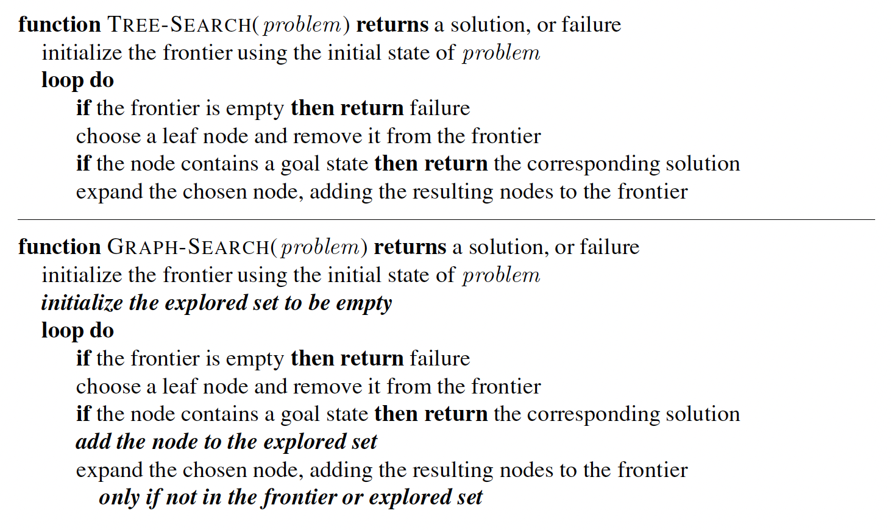
Template for Search Algorithms

Slide 19
{<Arad>},
{<A,Z>, <A,T>, <A, S>},
{<A,Z>, <A,T>, <A,S,A>, <A,S,O>, <A,S,F>, <A,S,R>}
{<A,Z>, <A,T>, <A,S,A>, <A,S,O>, <A,S,R>, <A,S,F,S>, <A,S,F,B>}
Solution: Arad → Sibiu → Fagaras → Bucharest
Cost: 140 + 99 + 211 = 450

Slide 20
{<Arad>},
{<A,Z>, <A,T>, <A, S>},
{<A,Z>, <A,T>, <A,S,A>, <A,S,O>, <A,S,F>, <A,S,R>}
{<A,Z>, <A,T>, <A,S,A>, <A,S,O>, <A,S,F>, <A,S,R,S>, <A,S,R,C>, <A,S,R,P>}
{<A,Z>, <A,T>, <A,S,A>, <A,S,O>, <A,S,F>, <A,S,R,S>, <A,S,R,C>, <A,S,R,P,R>, <A,S,R,P,C>, <A,S,R,P,B>}
Solution: Arad → Sibiu → Rimnicu Vilcea → Pitesti → Bucharest
Cost: 140 + 80 + 97 + 101 = 418

Slide 21
{<Arad>},
{<A,Z>, <A,T>, <A, S>},
{<A,Z>, <A,T>, <A,S,A>, <A,S,O>, <A,S,F>, <A,S,R>}
{<A,Z>, <A,T>, <A,S,A>, <A,S,O>, <A,S,R>, <A,S,F,S>, <A,S,F,B>}
…..
cycles can cause non-­‐termination!

Slide 22
Selection Rule
The order of path selection from OPEN intuitively has a critical effect on the operation of the search:
Whether or not a solution is found
The cost of the solution found.
The time and space required by the search.
All search techniques keep OPEN as an ordered set (e.g., a priority queue) based on key parameters

Slide 23
Critical Properties of Search
Completeness: Will the search algorithm always find a solution if a solution exists?
Optimality: Will the search always find the least cost solution? (when actions have costs)
Time complexity: How long does it take to find a solution?
Space complexity: What is the maximum number of nodes (paths) that have to be stored in memory?

Slide 24
Food for Thought - I
Try formalizing the following situations in the form of a static and a dynamic search problem:
Making a cup of tea
Purchasing a book from some e-commerce platform
Identifying an example to share with the class to resolve queries
Differential diagnosis by a doctor

Slide 25
Uninformed Search Strategies
These adopt a fixed rule for selecting the next state to be expanded.
The rule does not change irrespective of the search problem being solved.
These strategies do not take into account any domain specific information about the particular search problem.
Uninformed search techniques:
  Breadth-­First, Uniform-­Cost, Depth‐First, Depth­‐Limited, and Iterative­‐Deepening search

Slide 26
Breadth-­First Search

Slide 27
Breadth-­First Search
Water jugs problem
Start = (0,0); Goal = (*,2); Green = Newly Added.
Actions: Empty-­‐3-­‐Gallon, Empty-­‐4-­‐Gallon, Fill-­‐3-­‐Gallon, Fill-­‐4-­‐ Gallon, Pour-­‐3-­‐into-­‐4, Pour 4-­‐into-­‐3.
OPEN = {<(0,0)>}
OPEN = {<(0,0),(3,0)>, <(0,0),(0,4)>}
OPEN = {<(0,0),(0,4)>, <(0,0),(3,0),(0,0)>,
<(0,0),(3,0),(3,4)>, <(0,0),(3,0),(0,3) >}
OPEN = {<(0,0),(3,0),(0,0)>, <(0,0),(3,0),(3,4)>,
<(0,0),(3,0),(0,3)>, <(0,0),(0,4),(0,0)>,
<(0,0),(0,4),(3,4)>, <(0,0),(0,4),(3,1)>}

Slide 28
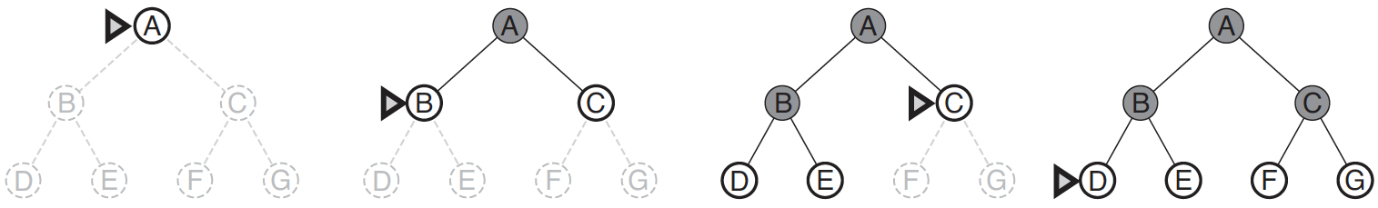
Breadth-­First Search
Level 0
#1: (0,0)
Level 1
#2: (3,0)
#3: (0,4)
Level 2
#4: (0,0)
#5: (3,4)
#6: (0,3)
#7: (0,0)
#8: (3,4)
#9: (3,1)
The path represented by each node is the path from the root to that node.
Breadth-­First explores the search space level by level.
Assumption: Uniform cost

Slide 29
Breadth-­First Properties
Completeness?
The length of the path removed from OPEN is non-­decreasing.
  We replace each expanded node n with an extension of n.
  All shorter paths are expanded prior before any longer path.
  Hence, eventually we must examine all paths of length d, and thus find a solution if one exists.
Optimality?
Will find shortest length solution
Least cost solution?
  Not necessarily: shortest solution not always cheapest solution if actions have varying costs

Slide 30
Breadth first Solution: Arad → Sibiu → Fagaras →Bucharest
Cost: 140 + 99 + 211 = 450
Lowest cost Solution: Arad → Sibiu → Rimnicu Vilcea → Pitesti → Bucharest Cost: 140 + 80 + 97 + 101 = 418

Slide 31
Breadth-­First Properties
Measuring time and space complexity.
b = maximum number of successors of any node (maximal branching factor).
d = depth of the shortest solution.
  Root at depth 0 is a path of length 1
  d = length of path -­ 1
  Time Complexity?
1 + b + b² + b³ + … + b^{d-­1} + b^{d} = O(b^{d})
Space Complexity?
O(b^{d–1}): nodes in the explored set
O(b^{d}): nodes in the frontier set
⇒ O(b^{d})

Slide 32
Uniform-­Cost Search

Slide 33
Uniform-­Cost Search
Keep OPEN ordered by increasing cost of the path.
Always expand the least cost path.
frontier is maintained as a priority queue ordered by lowest path cost g(n).
Identical to Breadth-first if each action has the same cost.

Slide 34
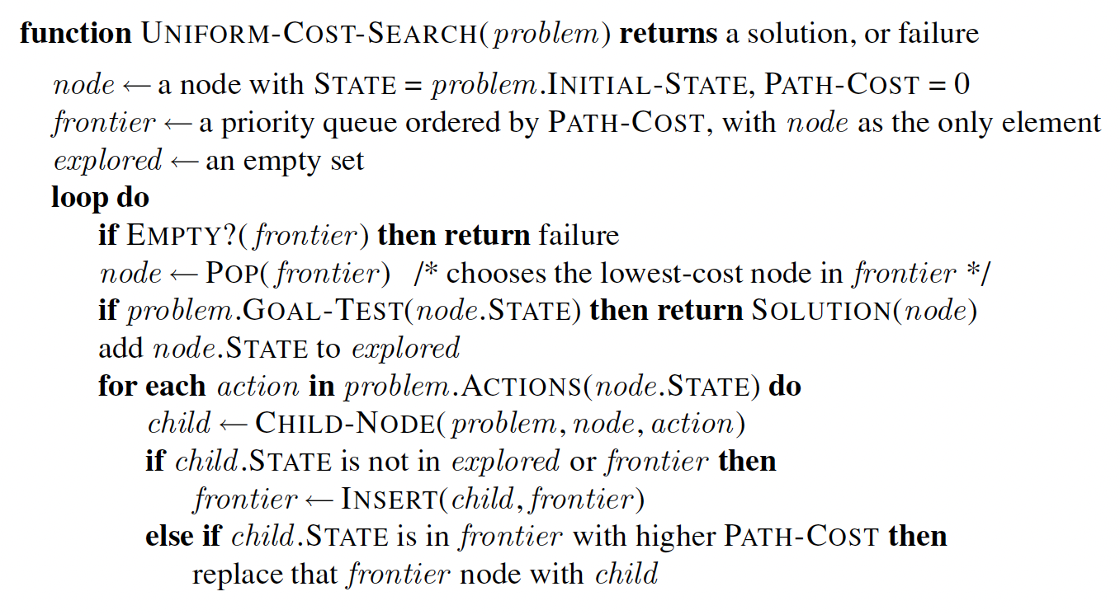
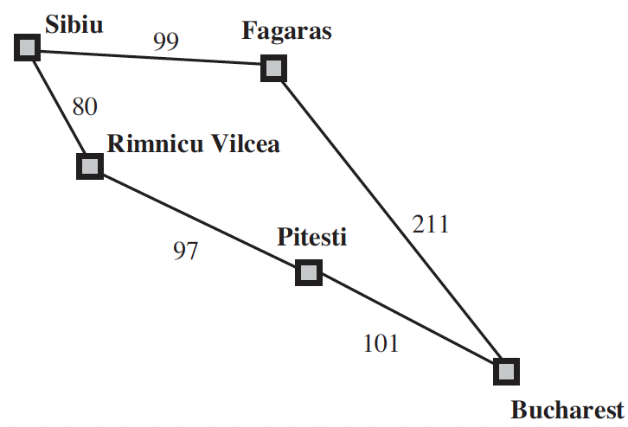
Uniform-­Cost Search
Problem: From Sibiu to Bucharest.
The successors of Sibiu are Rimnicu Vilcea and Fagaras, with costs 80 and 99, respectively.
The least-cost node, Rimnicu Vilcea, is expanded next, adding Pitesti with cost 80 + 97=177.
The least-cost node is now Fagaras, so it is expanded, adding Bucharest with cost 99+211=310.
Now a goal node has been generated, but uniform-cost search keeps going, choosing Pitesti for expansion and adding a second path to Bucharest with cost 80+97+101= 278.
Now the algorithm checks to see if this new path is better than the old one; it is, so the old one is discarded. Bucharest, now with g-cost 278, is selected for expansion and the solution is returned.

Slide 35
Uniform-­Cost Properties
Completeness?
If each transition has cost ≥ ε > 0.
The previous argument used for breadth first search holds: the cost of the path represented by each node n chosen to be expanded must be non-­decreasing.
Optimality?
Finds optimal solution if each transition has cost ≥ ε > 0.
  Explores paths in the search space in increasing order of cost. So must find minimum cost path to a goal before finding any higher cost path.

Slide 36
Uniform-­Cost Search : Proof of Optimality
Lemma 1.
Let c(n) be the cost of node n on OPEN (cost of the path represented by n). If n2 is expanded IMMEDIATELY after n1 then: c(n1) ≤ c(n2).
Proof:
n2 was on OPEN when n1 was expanded:
We must have c(n1) ≤ c(n2) otherwise n2 would have been selected for expansion rather than n1
n2 was added to OPEN when n1 was expanded:
Now c(n1) < c(n2) since the path represented by n2 extends the path represented by n1 and thus costs at least ε more.

Slide 37
Uniform-­Cost Search : Proof of Optimality
Lemma 2.
When node n is expanded every path in the search space with cost strictly less than c(n) has already been expanded.
Proof:
Let nk = <Start, s1, …, sk> be a path with cost less than c(n).
Let n0 = <Start>, n1 = <Start, s1>, n2 = <Start, s1, s2>, …, ni = <Start, s1, …, si>, …, nk = <Start, s1, …, sk>. Let ni be the last node in this sequence that has already been expanded by search.
So, ni+1 must still be on OPEN: it was added to open when ni was expanded. Also c(ni+1) ≤ c(nk) < c(n): c(ni+1) is a subpath of nk we have assumed that c(nk) is < c(n).
But then uniform-­‐cost would have expanded ni+1 not n.
So every node ni including nk must already be expanded, i.e., this lower cost path has already been expanded.

Slide 38
Uniform-­Cost Search : Proof of Optimality
Lemma 3.
The first time uniform-­cost expands a node n terminating at state S, it has found the minimal cost path to S (it might later find other paths to S but none of them can be cheaper).
Proof:
All cheaper paths have already been expanded, none of them terminated at S.
All paths expanded after n will be at least as expensive, so no cheaper path to S can be found later.
So, when a path to a goal state is expanded the path must be optimal (lowest cost).

Slide 39
Food for Thought - II
Try applying BFS and UCS algorithms to the search space formalizations you designed for the situations in Slide 24
Compare between the outcomes in terms of space & time requirements

Slide 40
Depth-­First Search

Slide 41
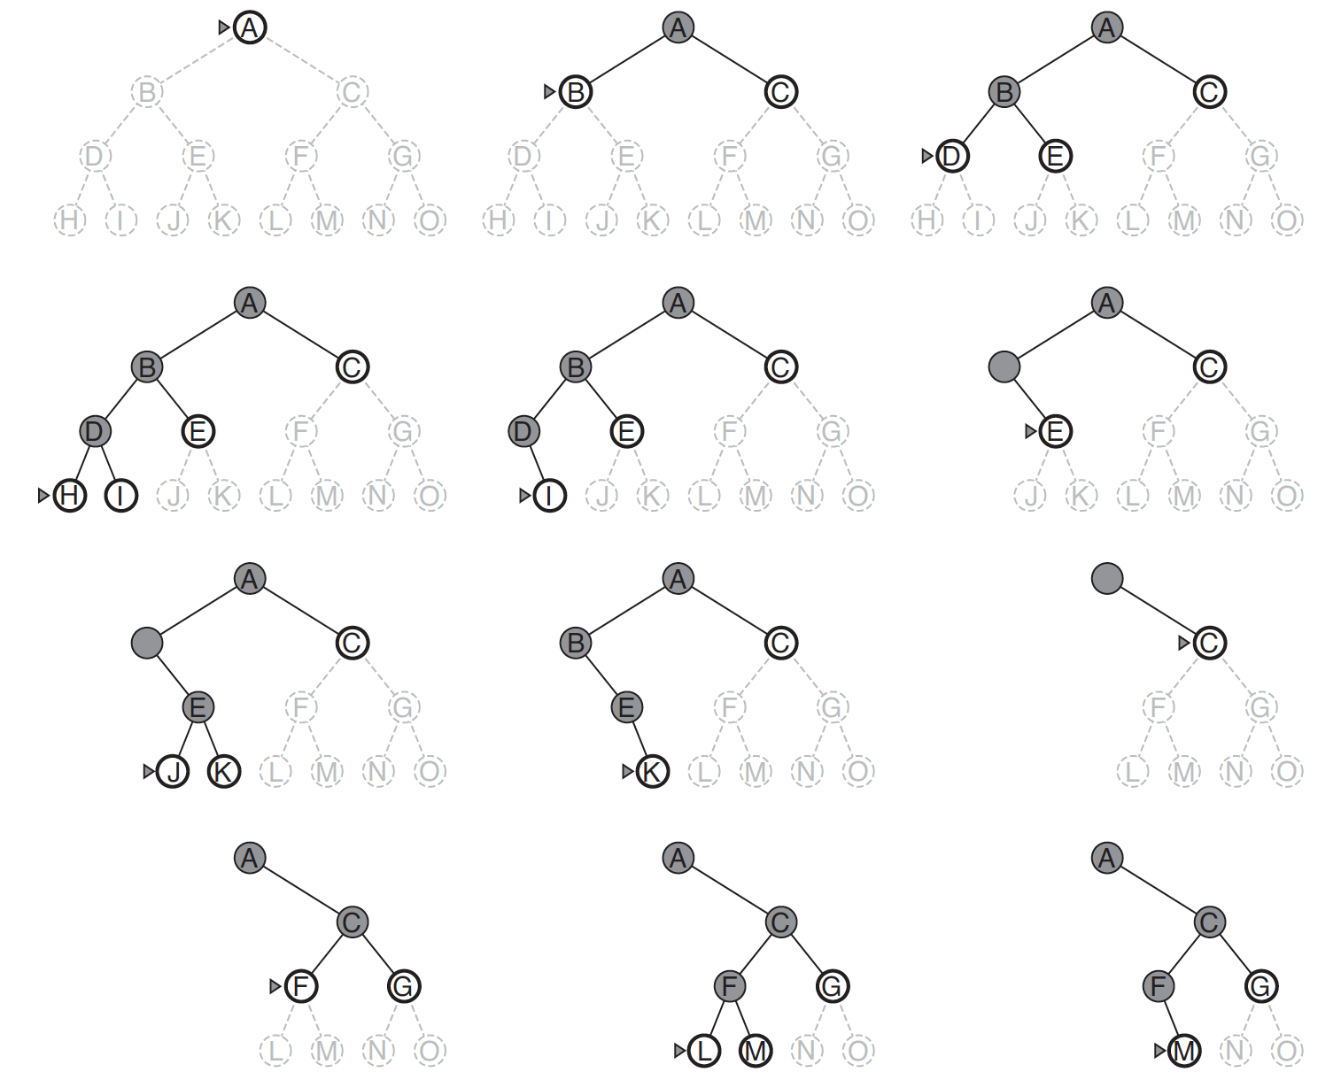
Depth-­First Search

Slide 42
Depth-­First Search
Differences in data structures to maintain OPEN in BFS vs UCS vs DFS?
Water jugs problem
Start = (0,0); Goal = (*,2); Green = Newly Added.
Actions: Empty-­‐3-­‐Gallon, Empty-­‐4-­‐Gallon, Fill-­‐3-­‐Gallon, Fill-­‐4-­‐ Gallon, Pour-­‐3-­‐into-­‐4, Pour 4-­‐into-­‐3.
OPEN = {<(0,0)>}
OPEN = {<(0,0), (3,0)>, <(0,0), (0,4)>}
OPEN = {<(0,0),(3,0),(0,0)>, <(0,0),(3,0),(3,4)>, <(0,0),(3,0),(0,3)>,
<(0,4),(0,0)>}
OPEN = {<(0,0),(3,0),(0,0),(3,0)>, <(0,0),(3,0),(0,0),(0,4)>
<(0,0), (3,0), (3,4)>, <(0,0),(3,0),(0,3)>, <(0,0),(0,4)>}

Slide 43
Depth-­First Search
Level 0
#1: (0,0)
Level 1
#2: (3,0)
(0,4)
Level 2
#3: (0,0)
(3,4)
(0,3)
Level 3
#4: (3, 0)
(0,4)
Red nodes are backtrack points (these nodes remain on OPEN).

Slide 44
Depth-­First Properties
Completeness?
Infinite paths - tree-search vs graph-search strategies
Optimality?
Not guaranteed ~ BFS
Time & space requirements?
Compare with BFS
Backtracking-support a natural consequence of the algorithm

Slide 45
Depth-­Limited Search

Slide 46
Depth-Limited Search
Breadth-first has space-optimization issues.
Depth-first can run along down a very long (~ infinite) path.
BFS and DFS prone to combinatorial explosion
Depth-limited search
Perform depth first search upto a pre-­specified depth limit (or diameter) D.
    Assumptions: ROOT is at DEPTH 0 & ROOT is a path of length 1.
No node representing a path of length more than D+1 is placed on OPEN.
“Truncate” search by expanding paths of length D+1 or less.
Infinite-path length somewhat handled.
Failure points: No solution / No solution within depth limits
Finds use in resource-constrained environments
Solution found only if such exists at DEPTH ≤ D.

Slide 47
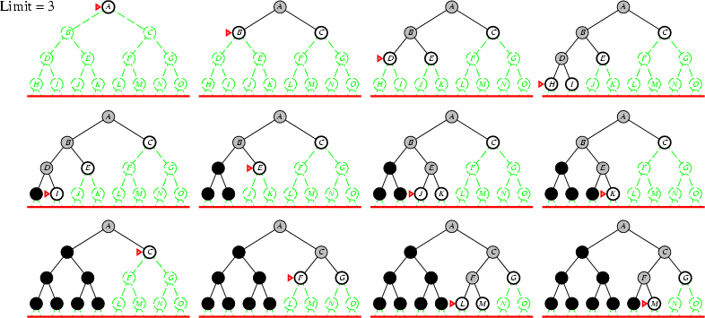
Depth-Limited Search

Slide 48
Iterative Deepening Search

Slide 49
Iterative Deepening Search
Executes DFS within a defined "depth limit" and iteratively elevates this limit until the goal node is successfully located
Combines BFS and DFS
Preferred uninformed search method when the search space is large and the depth of the solution is not known.
Starting at depth limit D = 0, iteratively increase D, while performing a depth limited search for each D.
Stop if a solution is found, or if the depth limited search failed without pruning nodes because of the depth limit.
  If no nodes were pruned and the search examined all paths in the state space and found no solution → no solution exists.

Slide 50
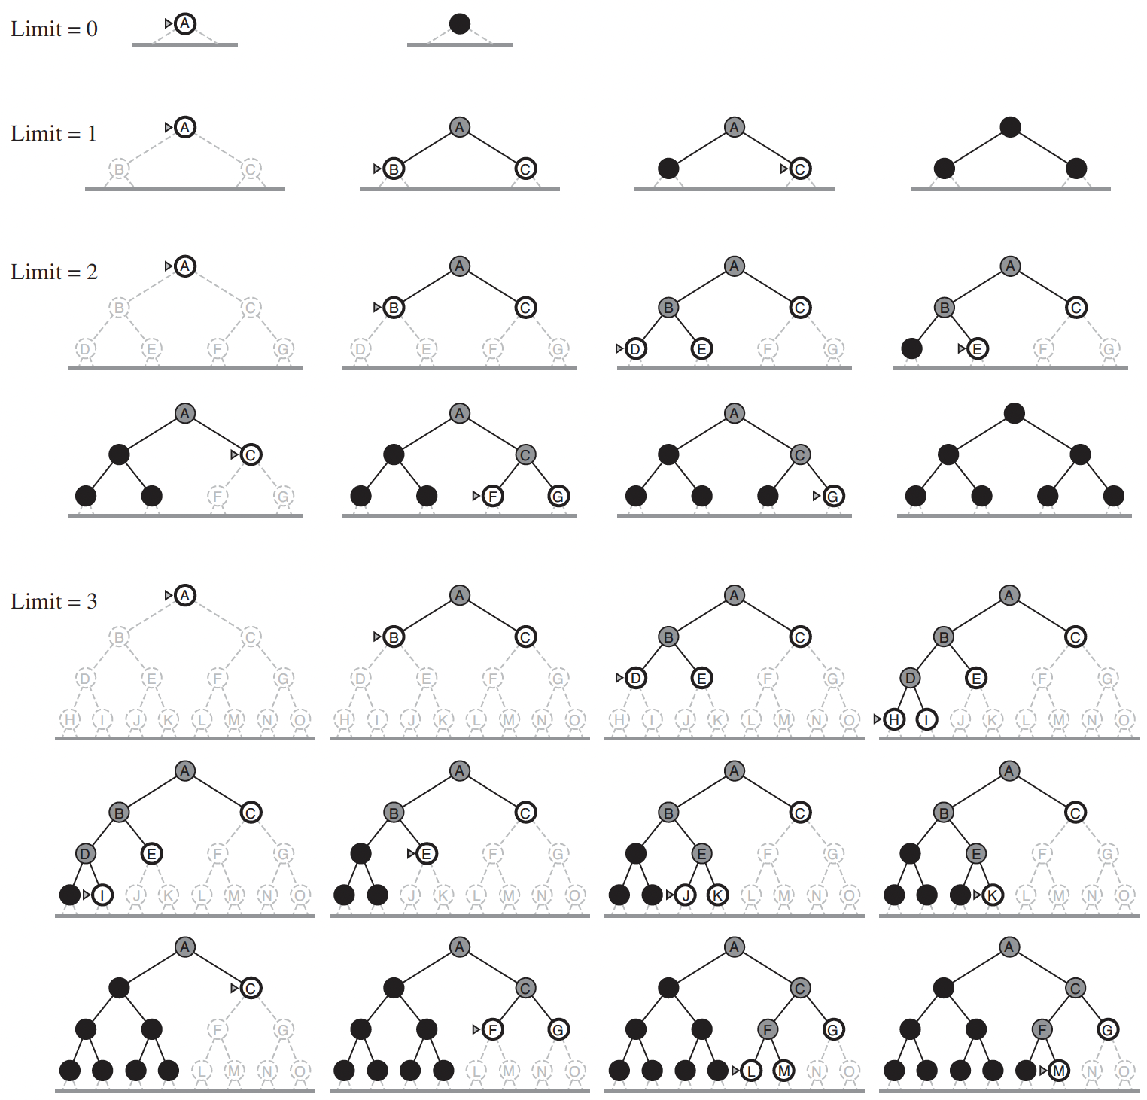
Iterative Deepening Search

Slide 51
Iterative Deepening Search Properties
Completeness?
Time Complexity?
Space Complexity?
Optimality?

Slide 52
Food for Thought - III
Try applying DFS, IDS, DLS algorithms to the search space formalizations you designed for the situations in Slide 24
Compare between the outcomes in terms of space & time requirements
How would you incorporate path / cycle checking in the solution strategies?

Slide 53
Heuristic Search (Informed Search)

Slide 54
Heuristic Search
Uninformed search - no evaluation of which nodes in OPEN are most promising; “look‐ahead” to the goal not done.
E.g., UCS → Always expand the cheapest path, without assessing the cost of getting to the goal from the end of the current path.
Often we possess knowledge about the “merit” of nodes:
  For cost of the solution, we might want to consider how costly it is to get to the goal from a node.
  For minimizing computation, we might want to consider how easy it is to find the goal from a node.

Slide 55
Heuristic Search
Merit of an OPEN node: different notions of merit.
If we are concerned about the cost of the solution, we might want to consider how costly it is to get to the goal from the terminal state of that node.
If we are concerned about minimizing computation in search we might want to consider how easy it is to find the goal from the terminal state of that node.
We will focus on the “cost of solution” notion of merit.

Slide 56
Heuristic Search
The idea is to develop a domain specific heuristic function h(n).
h(n) guesses the cost of getting to the goal from node n (i.e., from the terminal state of the path represented by n).
There are different ways of guessing this cost in different domains.
  heuristics are domain specific.

Slide 57
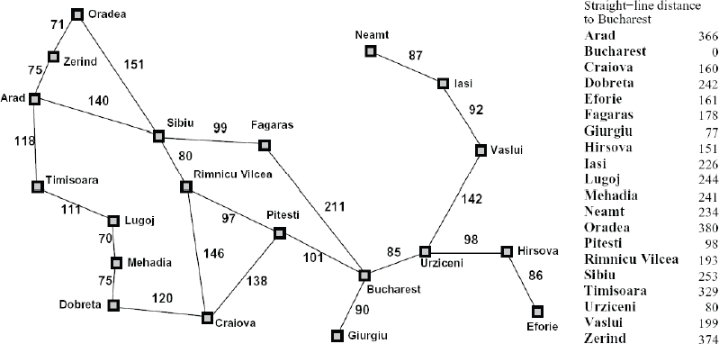
Example: Euclidean distance
Planning a path from Arad to Bucharest, we can utilize the straight line distance from each city to our goal. This lets us plan our trip by picking cities at each time point that minimize the distance to our goal.

Slide 58
Heuristic Search
If h(n₁) < h(n₂) this means that we guess that it is cheaper to get to the goal from n₁ than from n₂.
We require that
  h(n) = 0 for every node n whose terminal state satisfies the goal.
  Zero cost of achieving the goal from node that already satisfies the goal.

Slide 59
Using only h(n): Greedy best-­‐first search
We use h(n) to rank the nodes on OPEN
  Always expand node with lowest h-­‐value.
We are greedily trying to achieve a low cost solution.
However, this method ignores the cost of getting to n, so it can be lead astray exploring nodes that cost a lot but seem to be close to the goal:
→ step cost = 10
→ step cost = 100
S
10
100
n3
h(n1) = 20
h(n3) = 10
n1
10
n2
10
10
Goal

Slide 60
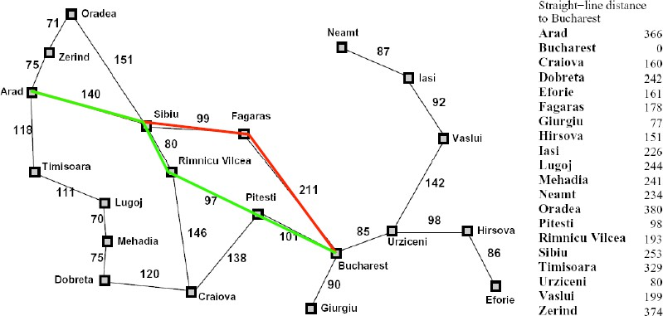
Greedy best-­‐first search example

Slide 61
A* search
Take into account the cost of getting to the node as well as our estimate of the cost of getting to the goal from the node.
Define an evaluation function f(n)
f(n) = g(n) + h(n)
  g(n) is the cost of the path represented by node n
  h(n) is the heuristic estimate of the cost of achieving the goal from n.
Always expand the node with lowest f-­‐value on OPEN.
The f-­‐value, f(n) is an estimate of the cost of getting to the goal via the node (path) n.
  I.e., we first follow the path n then we try to get to the goal. f(n) estimates the total cost of such a solution.

Slide 62
A* example

Slide 63

A* example

Slide 64
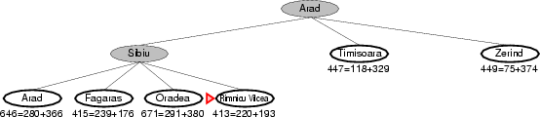
A* example

Slide 65
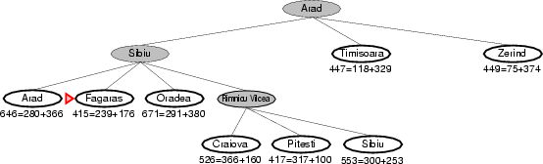
A* example

Slide 66
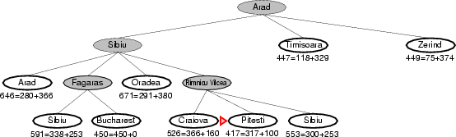
A* example

Slide 67
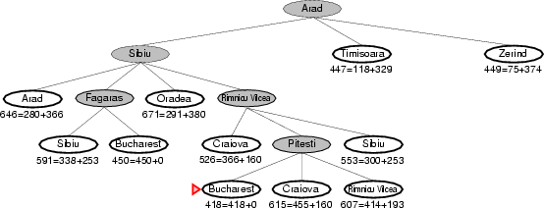
A* example

Slide 68
Properties of A* depend on conditions on h(n)
We want to analyze the behavior of the resultant search.
  Completeness, time and space, optimality?
To obtain such results we must put some further conditions on the heuristic function h(n) and the search space.

Slide 69
Conditions on h(n): Admissible
We always assume that c(s1, a, s2) ≥ ε > 0 for any two states s1 and s2 and any action a: the cost of any transition is greater than zero and can't be arbitrarily small.
Let h*(n) be the cost of an optimal path from n to a goal node (∞ if there is no path). Then an admissible heuristic satisfies the condition
h(n) ≤ h*(n)
  an admissible heuristic never over-­‐estimates the cost to reach the goal, i.e., it is optimistic
Hence h(g) = 0, for any goal node g
Also h*(n) = ∞ if there is no path from n to a goal node

Slide 70
Consistency (aka monotonicity)
A stronger condition than h(n) ≤ h*(n).
A monotone/consistent heuristic satisfies the triangle inequality: for all nodes n1, n2 and for all actions a
h(n1) ≤ C(n1,a,n2) + h(n2)
Where C(n1, a, n2) means the cost of getting from the terminal state of n1 to the terminal state of n2 via action a.
Note that there might be more than one transition (action) between n1 and n2, the inequality must hold for all of them.
Monotonicity implies admissibility.
  (forall n1, n2, a) h(n1) ≤ C(n1,a,n2) + h(n2) 🡺 (forall n) h(n) ≤ h*(n)

Slide 71
Consistency 🡺 Admissible
Assume consistency: h(n) ≤ c(n,a,n2) + h(n2)
Prove admissible: h(n) ≤ h*(n)
Proof:
Let n 🡪 n1 🡪 … 🡪 n* be an OPTIMAL path from n to a goal (with actions a1, a2). Note the cost of this path is h*(n), and each subpath (ni 🡪 … 🡪 n*) has cost equal to h*(ni).
If no path exists from n to a goal then h*(n) = ∞ and h(n) ≤ h*(n)
Otherwise prove h(n) ≤ h*(n) by induction on the length of this optimal path.
Base Case: n = n*
By our conditions on h, h(n) = 0 ≤ h(n)* = 0
Induction Hypothesis: h(n1) ≤ h*(n1)
h(n) ≤ c(n,a1,n1) + h(n1) ≤ c(n,a1,n1) + h*(n1) = h*(n)

Slide 72
Intuition behind admissibility
h(n) ≤ h*(n) means that the search won’t miss any promising paths.
If it really is cheap to get to a goal via n (i.e., both g(n) and h*(n) are low), then f(n) = g(n) + h(n) will also be low, and the search won’t ignore n in favor of more expensive options.
This can be formalized to show that admissibility implies optimality.
Monotonicity gives some additional properties when it comes to cycle checking.

Slide 73
Consequences of monotonicity
1. The f-­‐values of nodes along a path must be non-­‐decreasing.
Let <Start→ s1→ s2 → … → sk> be a path. Let ni be the subpath
<Start → s1 →… → si>:
We claim that: f(ni) ≤ f(ni+1)
Proof
f(ni) = c(Start→…→ ni) + h(ni)
≤ c(Start→…→ ni) + c(ni→ni+1) + h(ni+1)
≤ c(Start→ …→ ni→ ni+1) + h(ni+1)
≤ g(ni+1) + h(ni+1) = f(ni+1)

Slide 74
Consequences of monotonicity
2. If n2 is expanded immediately after n1, then f(n1) ≤ f(n2)
(the f-­‐value of expanded nodes is monotonic non-­‐decreasing)
Proof:
If n2 was on OPEN when n1 was expanded,
then f(n1) ≤ f(n2) otherwise we would have expanded n2.
If n2 was added to OPEN after n1's expansion, then n2 extends n1's path. That is, the path represented by n1 is a prefix of the path represented by n2. By property (1) we have f(n1)≤f(n2) as the f-­‐values along a path are non-­‐decreasing.

Slide 75
Consequences of monotonicity
3. Corollary: the sequence of f-­‐values of the nodes expanded by A* is non-­‐decreasing. I.e, If n2 is expanded after (not necessarily immediately after) n1, then f(n1) ≤ f(n2)
(the f-­‐value of expanded nodes is monotonic non-­‐decreasing)
Proof:
If n2 was on OPEN when n1 was expanded,
then f(n1) ≤ f(n2) otherwise we would have expanded n2.
If n2 was added to OPEN after n1's expansion, then let n be an ancestor of n2 that was present when n1 was being expanded (this could be n1 itself). We have f(n1) ≤ f(n) since A* chose n1 while n was present on OPEN. Also, since n is along the path to n2, by property (1) we have f(n)≤f(n2). So, we have f(n1) ≤ f(n2).

Slide 76
Consequences of monotonicity
When n is expanded every path with lower f-­‐value has already been expanded.
  Proof: Assume by contradiction that there exists a path <Start, n0, n1, ni-­‐1, ni, ni+1, …, nk> with f(nk) < f(n) and ni is its last expanded node.
    ni+1 must be on OPEN while n is expanded, so
      by (1) f(ni+1) ≤ f(nk) since they lie along the same path.
      since f(nk) < f(n) so we have f(ni+1) < f(n)
      by (2) f(n) ≤ f(ni+1) because n is expanded before ni+1.
    Contradiction from b&c!

Slide 77
Consequences of monotonicity
With a monotone heuristic, the first time A* expands a state, it has found the minimum cost path to that state.
Proof:
  Let PATH1 = <Start, s0, s1, …, sk, s> be the first path to a state s found. We have f(path1) = c(PATH1) + h(s).
  Let PATH2 = <Start, t0, t1, …, tj, s> be another path to s found later. we have f(path2) = c(PATH2) + h(s).
    Note h(s) is dependent only on the state s (terminal state of the path) it does not depend on how we got to s.
  By property (3), f(path1) ≤ f(path2)
  hence: c(PATH1) ≤ c(PATH2)

Slide 78
Consequences of monotonicity
Complete.
Yes, consider a least cost path to a goal node
  SolutionPath = <Start→ n1→ …→ G> with cost c(SolutionPath). Since h(G) = 0, this means that f(SolutionPath) = cost(SolutionPath)
  Since each action has a cost ≥ ε > 0, there are only a finite number of paths that have f-­‐value < c(SolutionPath). None of these paths lead to a goal node since SolutionPath is a least cost path to the goal.
  So eventually SolutionPath, or some equal cost path to a goal must be expanded.
Time and Space complexity.
When h(n) = 0, for all n h is monotone.
  A* becomes uniform-­‐cost search!
It can be shown that when h(n) > 0 for some n and still admissible, the number of nodes expanded can be no larger than uniform-­‐cost.
Hence the same bounds as uniform-­‐cost apply. (These are worst case bounds). Still exponential unless we have a very good h!
In real world problems, we sometimes run out of time and memory. IDA* can sometimes be used to address memory issues, but IDA* isn’t very good when many cycles are present.

Slide 79
Consequences of monotonicity
Optimality
Yes, by (5) the first path to a goal node must be optimal.
5. With a monotone heuristic, the first time A* expands a state, it has found the minimum cost path to that state.
Cycle Checking
We can use a simple implementation of cycle checking (multiple path checking)-­‐-­‐-­‐just reject all search nodes visiting a state already visited by a previously expanded node. By property (5) we need keep only the first path to a state, rejecting all subsequent paths.

Slide 80
Admissibility without monotonicity
When “h” is admissible but not monotonic.
Time and Space complexity remain the same. Completeness holds.
Optimality still holds (without cycle checking), but need a different argument: don't know that paths are explored in order of cost.

Slide 81
Admissibility without monotonicity
What about Cycle Checking?
No longer guaranteed we have found an optimal path to a node the first time we visit it.
So, cycle checking might not preserve optimality.
  To fix this: for previously visited nodes, must remember cost of previous path. If new path is cheaper must explore again.

Slide 82
Space Problems with A*
A* has the same potential space problems as BFS or UCS
IDA* -­‐ Iterative Deepening A* is similar to Iterative Deepening Search and similarly addresses space issues.

Slide 83
IDA* -­‐ Iterative Deepening A*
Objective: reduce memory requirements for A*
Like iterative deepening, but now the “cutoff” is the f-­‐value (g+h) rather than the depth
At each iteration, the cutoff value is the smallest f-­‐value of any node that exceeded the cutoff on the previous iteration
Avoids overhead associated with keeping a sorted queue of nodes, and the open list occupies only linear space.
Two new parameters:
  curBound (any node with a bigger f-­‐value is discarded)
  smallestNotExplored (the smallest f-­‐value for discarded nodes in a round) when OPEN becomes empty, the search starts a new round with this bound.
    Easier to expand all nodes with f-­‐value EQUAL to the f-­‐limit. This way we can compute “smallestNotExplored” more easily.

Slide 84
Constructing Heuristics

Slide 85
Building Heuristics: Relaxed Problem
One useful technique is to consider an easier problem, and let h(n) be the cost of reaching the goal in the easier problem.
8-­‐Puzzle moves.
  Can move a tile from square A to B if
    A is adjacent (left, right, above, below) to B
    and B is blank
Can relax some of these conditions
can move from A to B if A is adjacent to B (ignore whether or not position is blank)
can move from A to B if B is blank (ignore adjacency)
can move from A to B (ignore both conditions).

Slide 86
Building Heuristics: Relaxed Problem
#3 “can move from A to B (ignore both conditions)”.
leads to the misplaced tiles heuristic.
  To solve the puzzle, we need to move each tile into its final position.
  Number of moves = number of misplaced tiles.
  Clearly h(n) = number of misplaced tiles ≤ the h*(n) the cost of an optimal sequence of moves from n.
#1 “can move from A to B if A is adjacent to B (ignore whether or not position is blank)”
leads to the manhattan distance heuristic.
  To solve the puzzle we need to slide each tile into its final position.
  We can move vertically or horizontally.
  Number of moves = sum over all of the tiles of the number of vertical and horizontal slides we need to move that tile into place.
  Again h(n) = sum of the manhattan distances ≤ h*(n)
    in a real solution we need to move each tile at least that far and we can only move one tile at a time.

Slide 87
Building Heuristics: Relaxed Problem
Comparison of IDS and A* (average total nodes expanded ):
Depth | IDS | A*(Misplaced) h1 | A*(Manhattan) h2
10 | 47,127 | 93 | 39
14 | 3,473,941 | 539 | 113
24 | -­‐-­‐-­‐ | 39,135 | 1,641
Let h1=Misplaced, h2=Manhattan
Does h2 always expand fewer nodes than h1?
  Yes! Note that h2 dominates h1, i.e. for all n: h1(n)≤h2(n). From this you can prove h2 is faster than h1 (once both are admissible).
  Therefore, among several admissible heuristic the one with highest value is the fastest.

Slide 88
Building Heuristics: Relaxed Problem
The optimal cost to nodes in the relaxed problem is an admissible heuristic for the original problem!
Proof Idea: the optimal solution in the original problem is a solution for relaxed problem, therefore it must be at least as expensive as the optimal solution in the relaxed problem.
So admissible heuristics can sometimes be constructed by finding a relaxation whose optimal solution can be easily computed.

Slide 89











Building Heuristics: Pattern databases
Try to generate admissible heuristics by solving a subproblem and storing the exact solution cost for that subproblem
See Chapter 3.6.3 if you are interested.

